Slide 1
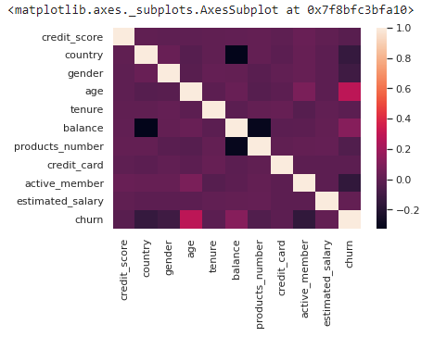
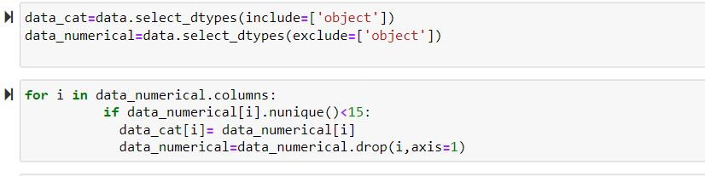
Preprocessing
Preprocessing involves transforming and preparing the data to ensure it is in a suitable format for analysis. Here are some steps you can follow for preprocessing data for bank customer churn prediction:
Statistics –
preprocessing statistics play a vital role in preparing
the data for modeling.Here Correlation Analysis is the
preprocessing statistics commonly used in
bank customer churn prediction:
Correlation Analysis: Correlation analysis
helps in understanding the relationships between different
variables and their association with customer churn.
Code:
Variable types-
-catogerical
We find unique vales in the data and if the number of unique
values is < 15 then we call it as catogerical variables.
-numerical
We check missing values .

Slide 2
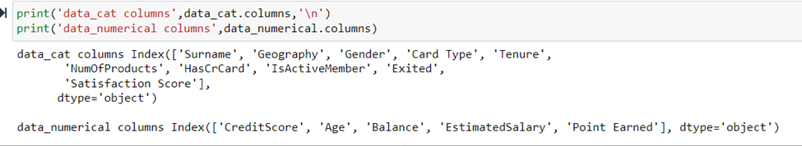
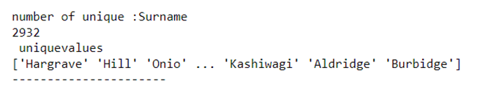
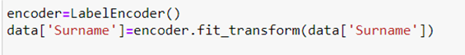
Encoding :
Encoding in preprocessing refers to the process of converting raw textual or categorical data into a numerical representation that can be used by machine learning algorithms
Lable Encoding :

Slide 3
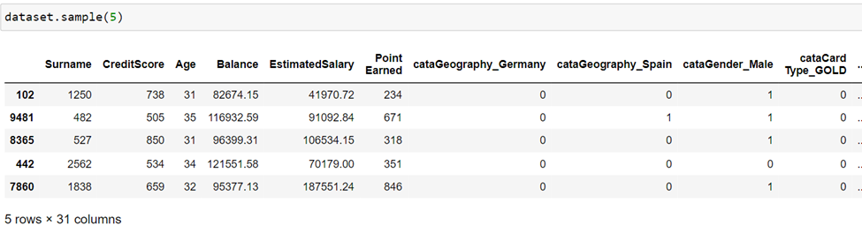
One-hot encoding :
New processed dataset :

Slide 4
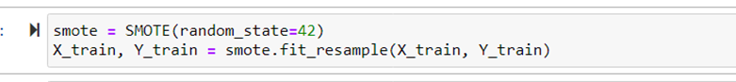
Handling imbalances : Imbalanced datasets can pose challenges for machine learning models, as they tend to be biased towards the majority class and struggle to accurately predict the minority class. Class Weighting:
Assign higher weights to the minority class during model training to give it more importance. This can be done by setting class weights inversely proportional to their frequency
For svm and logistic models we have used class weight method .
'svm__class_weight': ['balanced', None]
SMOTE (Synthetic Minority Over-sampling Technique):
It is an over sampling techneque which is used to Replicate or create new synthetic samples in the minority class to increase its representation.

Slide 5
Feature Selection Feature selection is an important step in the model building process that involves selecting a subset of relevant features from the available set of variables.
RFE(Recursive Feature Elimination):
RFE is an iterative algorithm that starts with all the features and eliminates the least important features in each iteration until a specified number of features or a desired level of performance is achieved.
There are some general approach for determining the number of features to select using RFE:
Start with a larger value:
Apply RFE and evaluate performance:
Decrease n_features_to_select:
Select the optimal n_features_to_select:

Slide 6
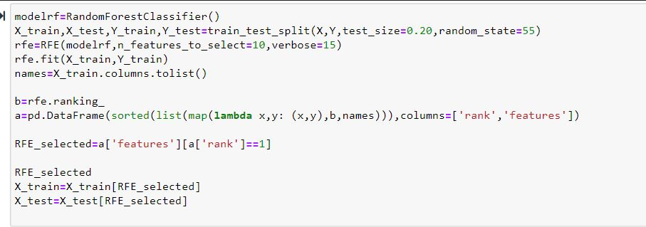
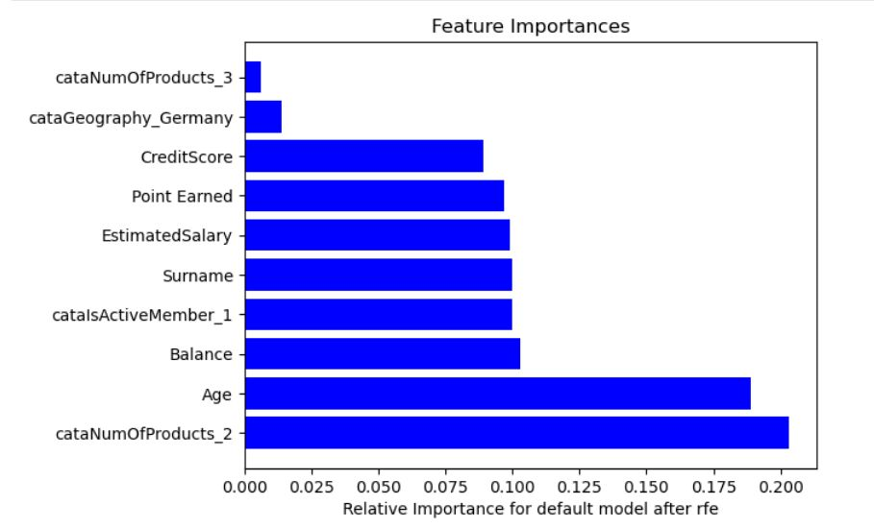

Slide 7
Model Selection: Based on the evaluation metrics and your specific requirements, select the best-performing model’s to proceed with further analysis. Consider factors such as accuracy, interpretability, and the trade-off between false positives and false negatives, depending on the bank's priorities.
Evaluation metrics:
Evaluation metrics are used to assess the performance and effectiveness of machine learning models. They provide quantitative measures to gauge how well a model is performing in making predictions or classifications

Slide 8
METRICS OF CONFUSION MATRIX
BASIC ELEMENTS:
-True Positive (TP)
-True Negative (TN)
-False Positive (FP )
-False Negative (FN)
METRICS:
-Accuracy: calculated as (TP + TN) / (TP + TN + FP + FN).
-Precision: calculated as TP / (TP + FP).
-Recall: calculated as 2 * (precision * recall) / (precision + recall).
-Specificity: calculated as TN / (TN + FP).

Slide 9
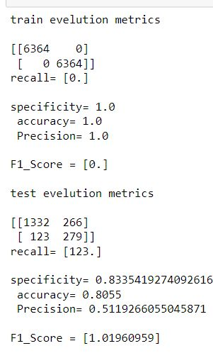
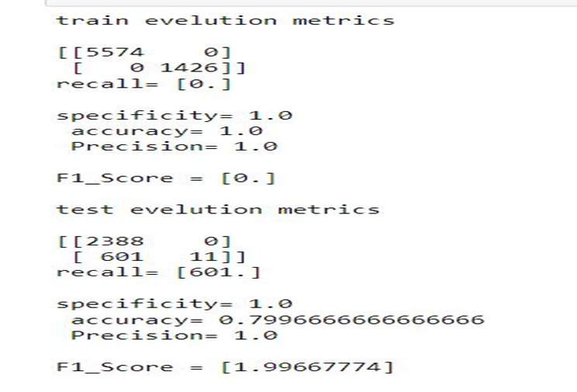
Selecting algorithm by building default models:
Random Forest: Support Vector Machines:

Slide 10
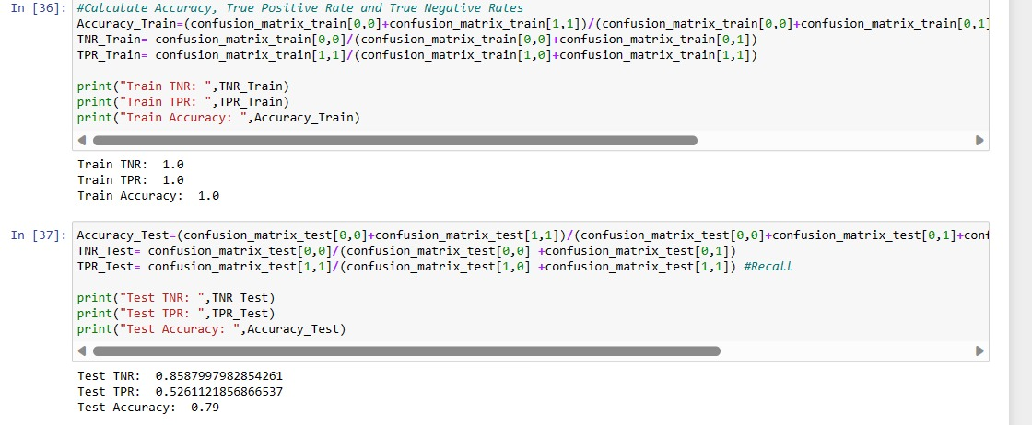
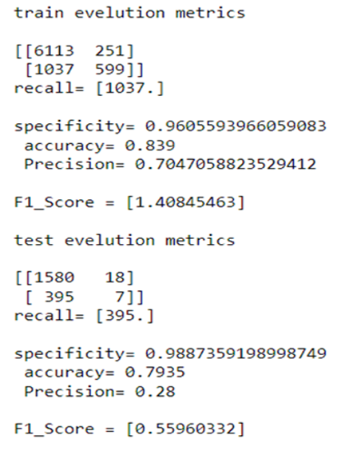
Decision tree algorithm: Logistic regression:

Slide 11
Hyperparametric tuning process
Hyperparametric tuning involves searching for best combination of hyperparameter values. It aims to find the configuration that maximizes the model’s performance metric e.g.,accuracy on a validation set.
NEED FOR HYPER PARAMETER TUNING
Generalization improvement
Adaptation to problem characteristics
Robustness and stability:
Resource utilization
Hyperparameter tuning can be performed through various techniques, including grid search, random search, Bayesian optimization, genetic algorithms, and more. These methods systematically explore the hyperparameter space, evaluating different configurations and selecting the best ones based on performance metrics.

Slide 12
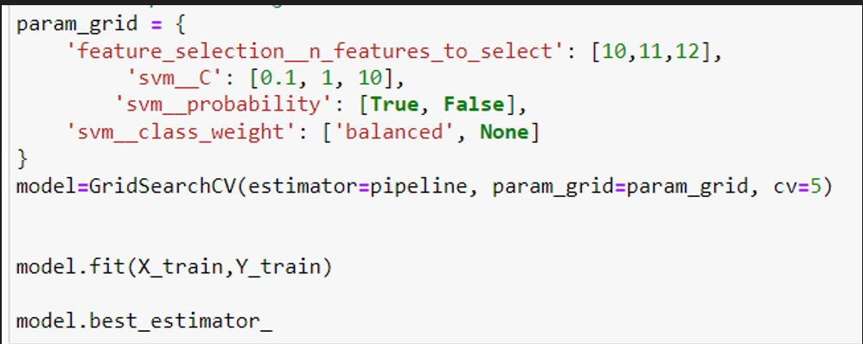
GridSearchCV:
Grid search with cross-validation (GridSearchCV) is a popular method for hyperparameter tuning in machine learning. It systematically searches for the optimal combination of hyperparameter values by evaluating the model's performance across different parameter settings using cross-validation.
Define parameter grid
Set up cross-validation
Perform grid search
best_params_

Slide 13
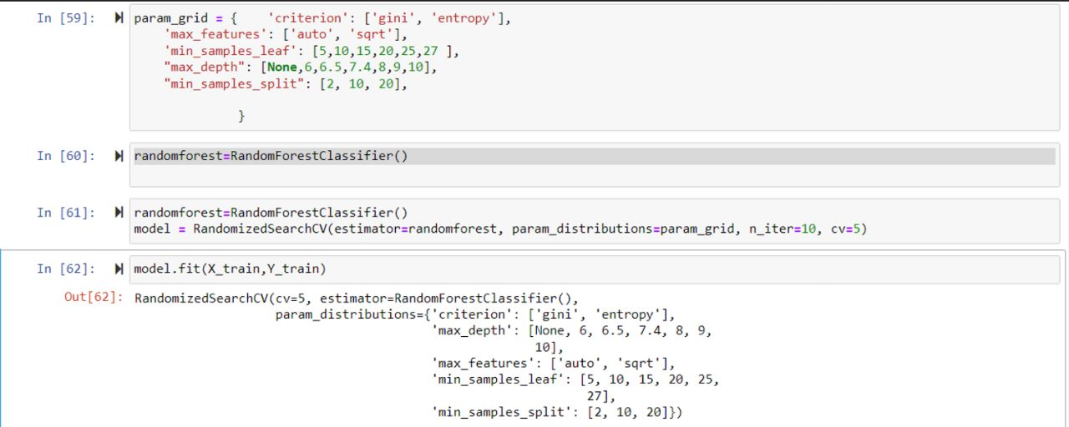
Randomized Search:
Randomized search explores a random subset of the hyperparameter space. By randomly sampling combinations, it can efficiently cover a wide range of values and potentially discover good configurations without examining all possibilities

Slide 14
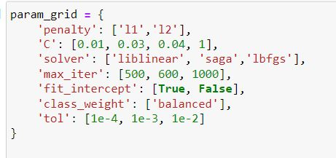
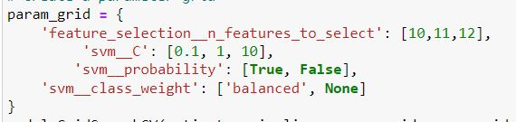
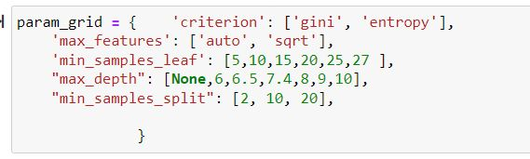
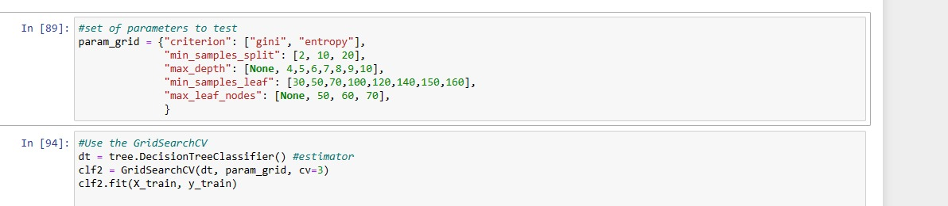
Hyper param for each algorithm:
Logistic: Svm:
Random forest: Decision tree:

Slide 15
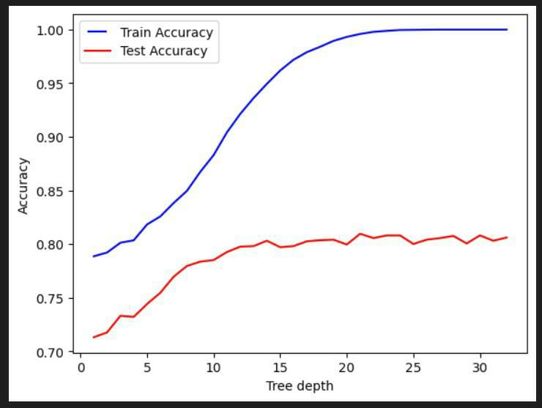
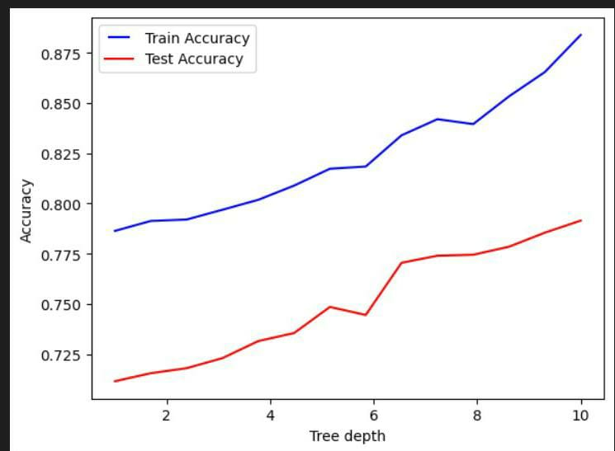
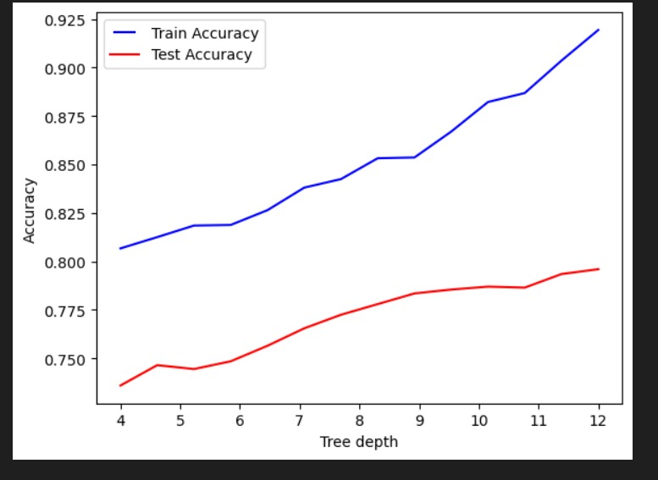
Hyperparameter values:
Random forest max_depth
1. 2.
3.

Slide 16
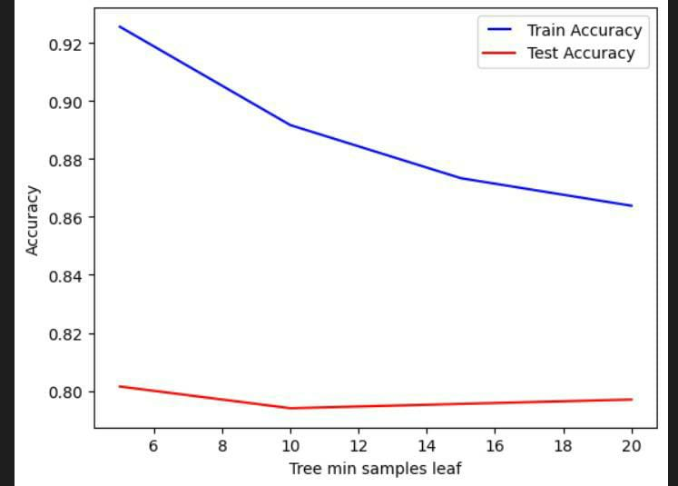
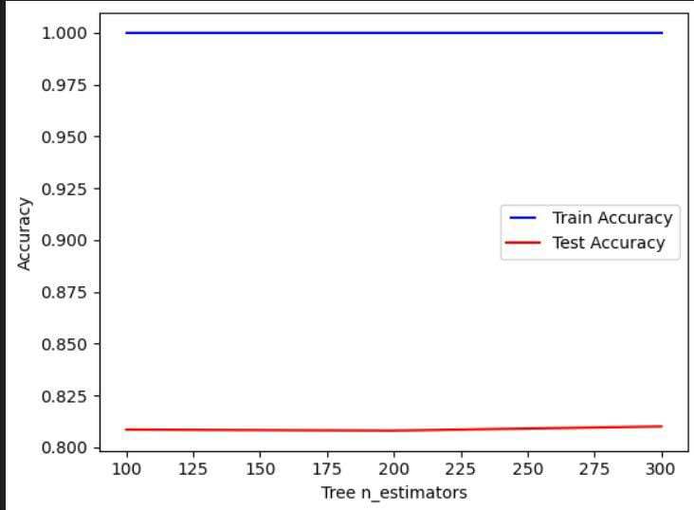
Min_Sample Leaf:
n_estimator :

Slide 17
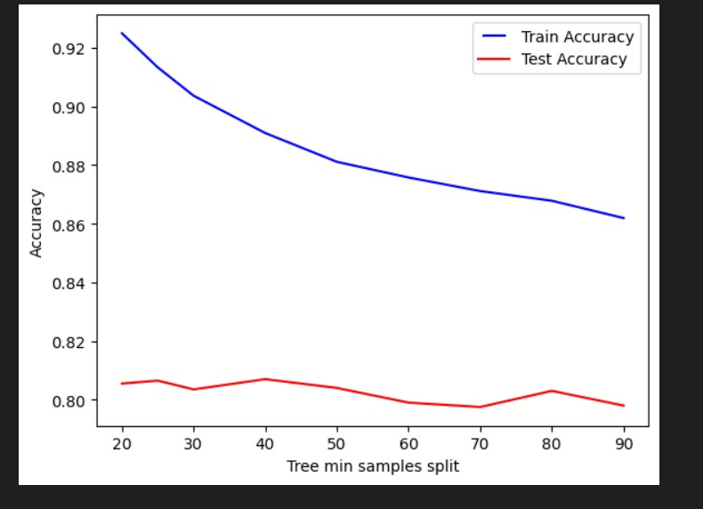
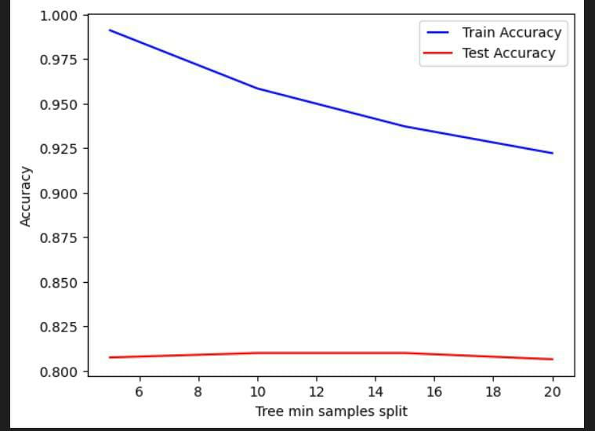
min samples split:
1. 2.

Slide 18
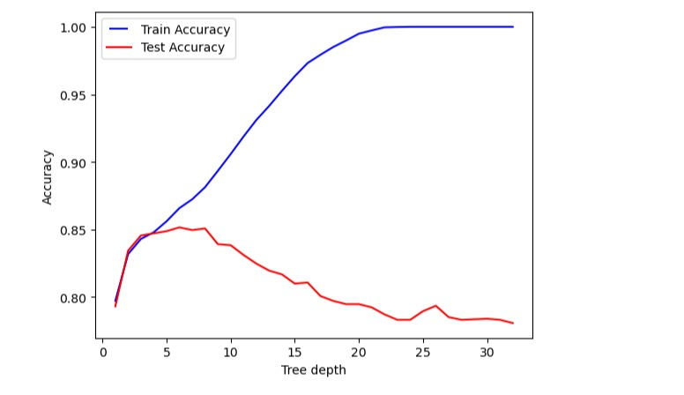
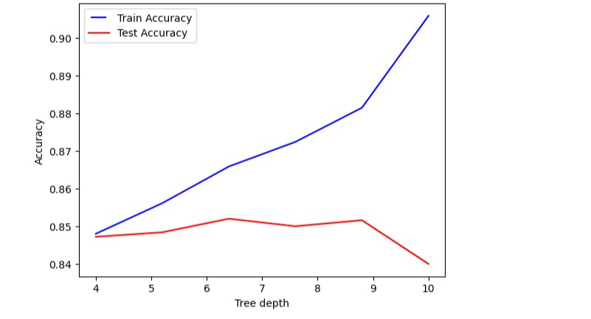
Decision tree max depth:
1. 2.

Slide 19
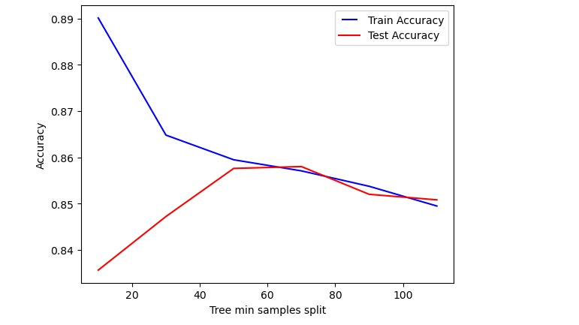
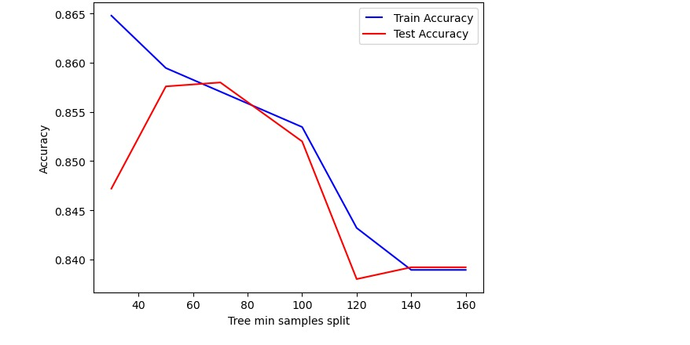
min sample leafs decision tree:

Slide 20
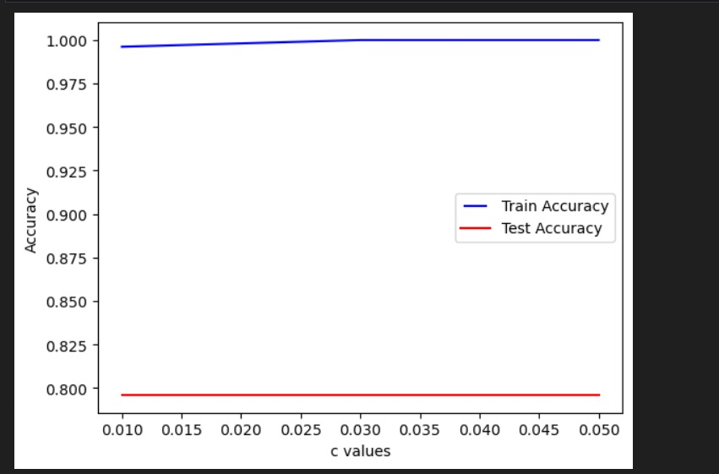
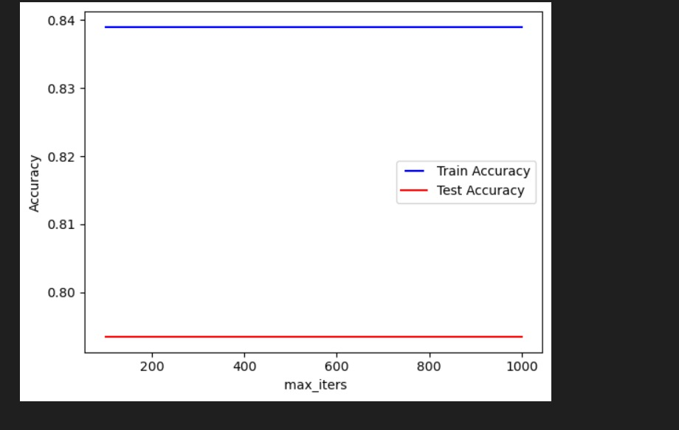
svm algorithm c value: logistic regressinon iter value:

Slide 21
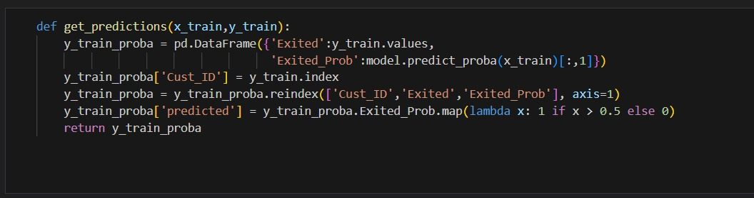
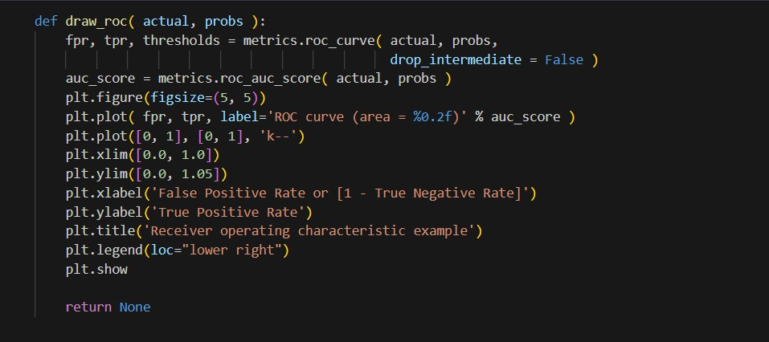
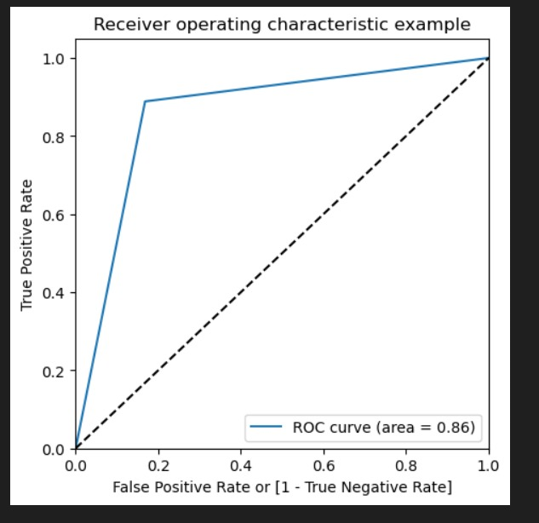
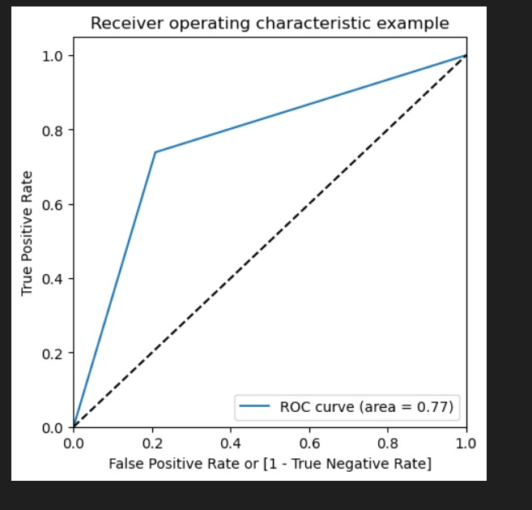
Getting the optimal threshold:
Random forest: 1. 2.
3.

Slide 22
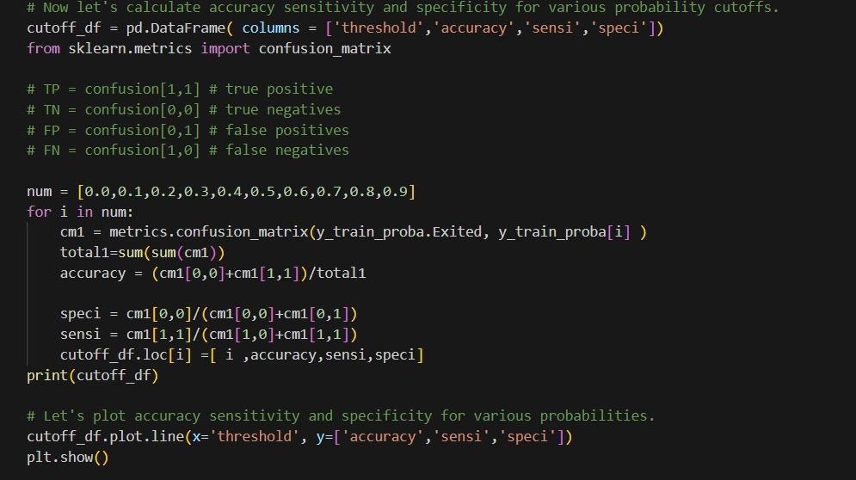
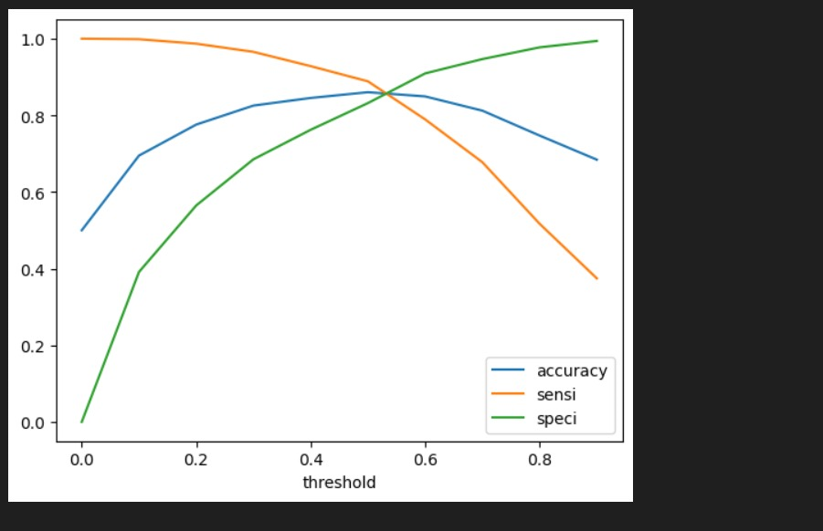
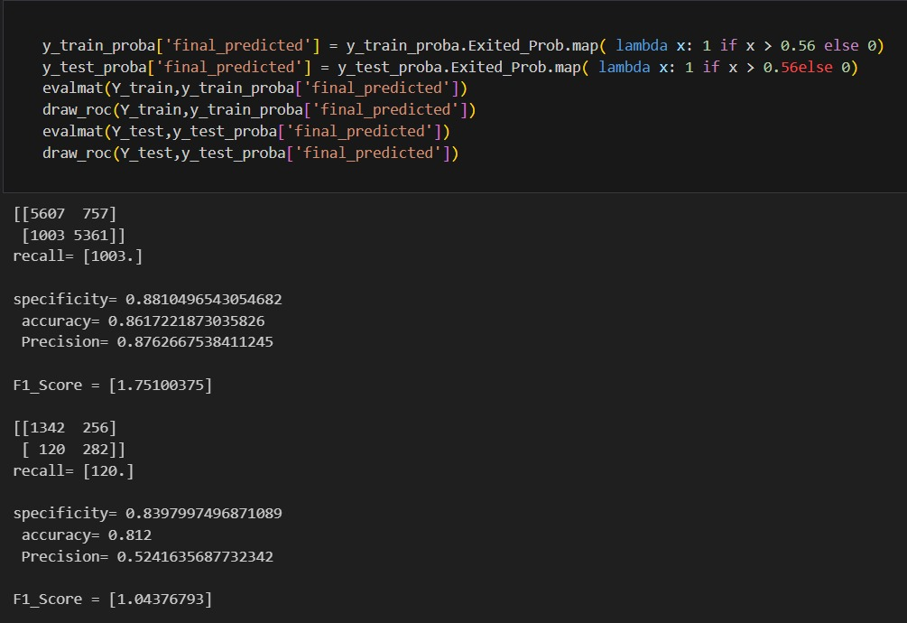

Slide 23
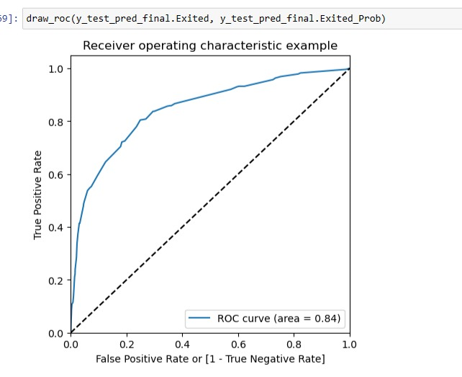
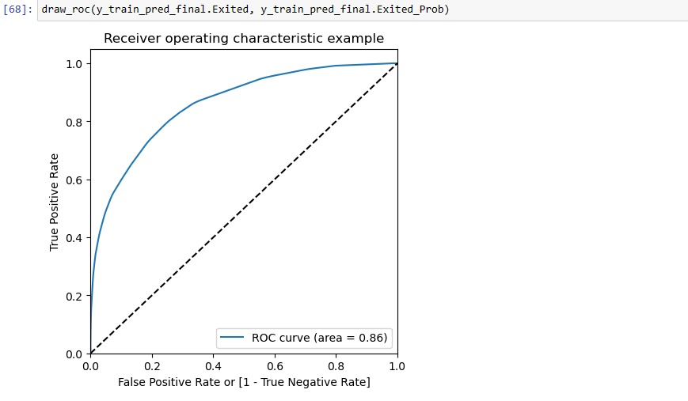
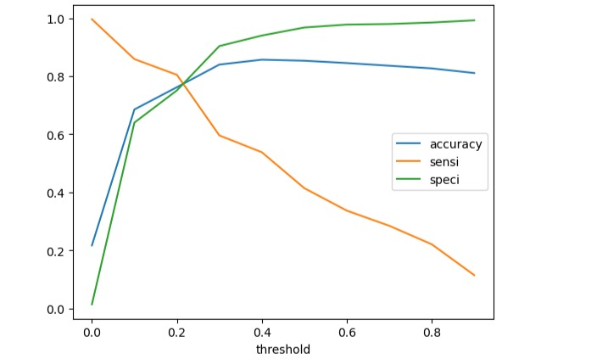
Decision tree :

Slide 24
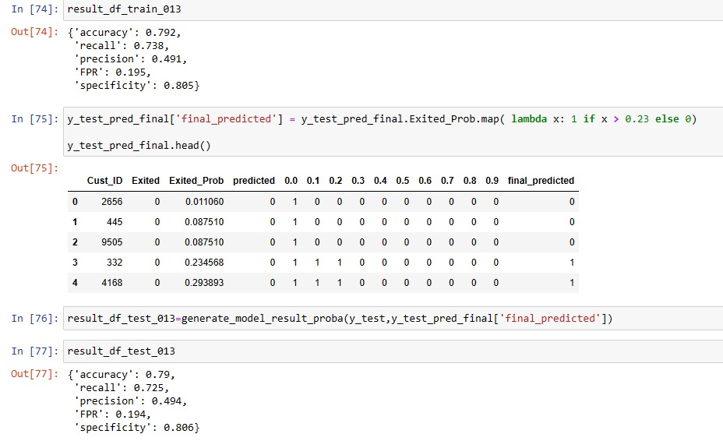
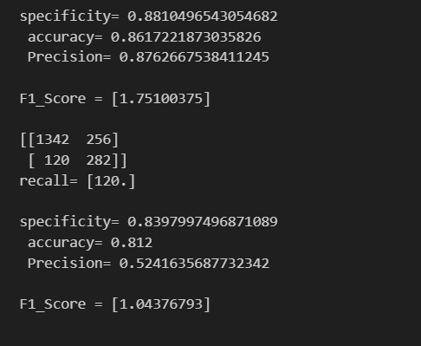
Accuracy of every models:
decision tree: random forest:

Slide 25
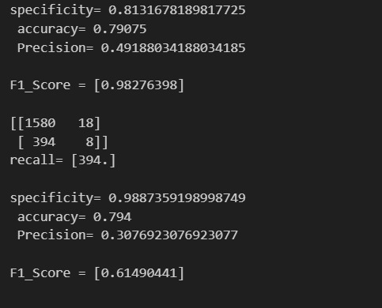
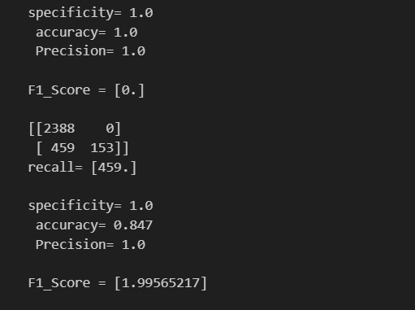
Svm: logistic regression:

Slide 26


